Slide 1

Geo-Economic Optimization for Strategic EV Charger Location
TEAM MUESLI
Akshat Singh Chauhan
Manthan Jigar Shah
Harsh Suhan

Slide 2
Problem statement
Our project addresses the critical urban sustainability challenge of optimal placement of Electric Vehicle Charging Stations (EVCS) in cities. As the world transitions towards electric mobility to combat climate change and reduce dependency on fossil fuels, the lack of adequate charging infrastructure remains a significant barrier to widespread EV adoption.
This problem is crucial because:
It directly impacts the feasibility and convenience of EV use in urban areas.
Proper EVCS placement can encourage EV adoption, reducing urban air pollution and greenhouse gas emissions.
It affects urban planning and development, influencing traffic patterns and land use.
Optimal placement ensures efficient use of resources and maximizes the utility of each charging station.

Slide 3
Solution Description
Our AI-driven solution leverages machine learning algorithms to predict optimal locations for EVCS placement based on spatial-economic factors. The core innovation lies in our comprehensive approach that considers multiple urban features:
Geospatial data: City layouts, road networks, and existing infrastructure.
Points of Interest (POI): Locations where EV users are likely to spend time.
Population density: As a proxy for potential EV adoption and charging demand.
Existing EVCS locations: To identify underserved areas.
The solution works by:
Dividing cities into 500m x 500m grid cells.
Collecting and preprocessing relevant data for each grid cell.
Training machine learning models on this data to predict the suitability of each cell for EVCS placement.
Evaluating and comparing different models to find the best performer.
Using the best model to predict optimal EVCS locations across the entire city.
AI is leveraged through the use of various machine learning classifiers (e.g., Random Forest, Decision Trees, Naive Bayes) that learn patterns from the spatial-economic data to make predictions. This approach allows for data-driven, objective decision-making in EVCS placement, considering complex interactions between various urban factors.

Slide 4
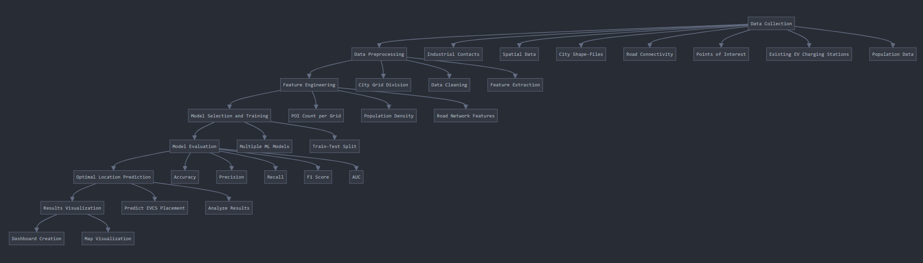
FLOWCHAT FOR THE PROJECT

Slide 5
Technical Architecture
We evaluated multiple machine learning models, including:
Decision Tree Classifier
Random Forest Classifier
Bernoulli Naive Bayes
Logistic Regression
Bagging Classifier
Passive Aggressive Classifier
Extra Trees Classifier
AdaBoost Classifier
Ridge Classifier
The Bernoulli Naive Bayes model showed the best overall performance in our experiments.

Slide 6
Datasets
We created a custom dataset combining various spatial-economic features:
City shape files from OpenStreetMap (OSM)
Road network data from OSM
Points of Interest data from OSM
Existing EVCS locations from the German Federal Network Agency
Population density data from Meta's high-resolution population density dataset

Slide 7
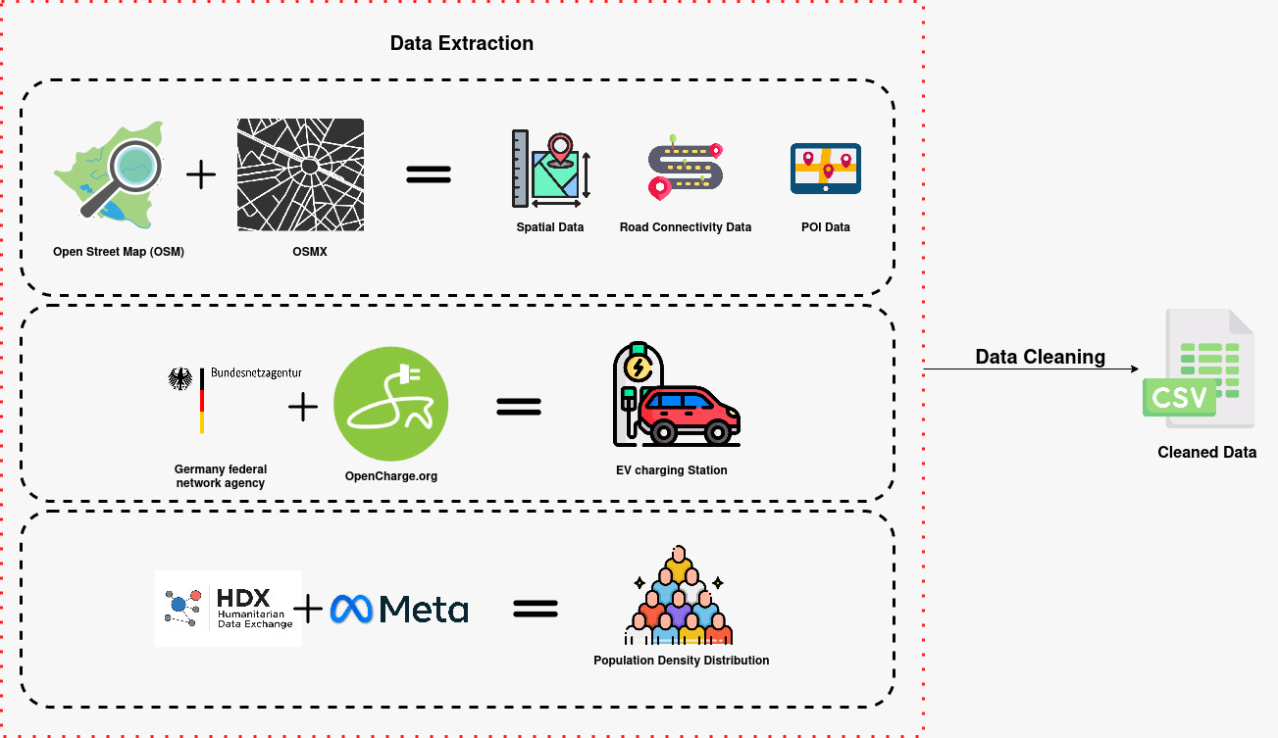

Slide 9
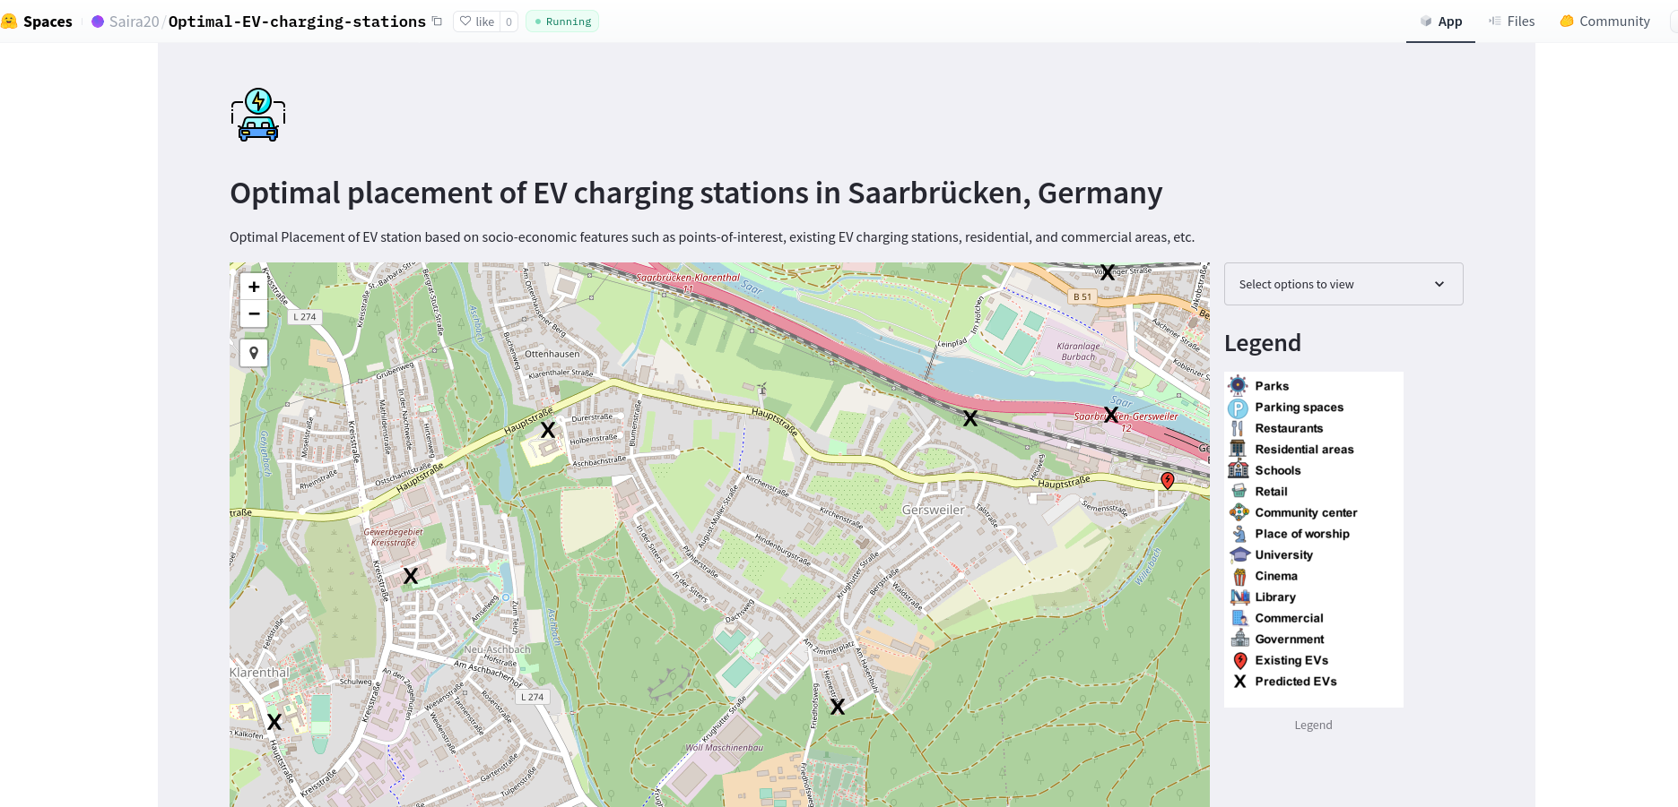
Results

Slide 10
Social, Ecological and Economic Impact
Our solution promotes sustainability by:
Facilitating the adoption of electric vehicles, which reduces greenhouse gas emissions and air pollution in urban areas.
Optimizing the use of resources by ensuring efficient placement of charging infrastructure.
Supporting the transition to renewable energy in the transportation sector.

Slide 11
Integration with Existing Ecosystems
Our solution is designed to integrate seamlessly with existing urban infrastructure and systems:
City Planning: The tool can be used by city planners to inform decisions about EVCS placement and urban development.
Energy Grid: By considering population density and existing infrastructure, our solution helps balance the load on the electrical grid.
Private Sector: Companies looking to invest in EVCS can use our tool to identify optimal locations for their stations.
Public Transportation: The solution can be integrated with public transportation planning to create intermodal charging hubs.
Smart City Initiatives: Our AI-driven approach aligns with and can be incorporated into broader smart city projects.

Slide 12
Future Potential and Scalability
Our solution has significant potential for real-world deployment and scalability:
Adaptability: The model can be easily adapted to different cities by inputting local spatial-economic data.
Continuous Improvement: As more EVCS are deployed, the model can learn from real-world usage data to improve its predictions.
Expandability: The framework can be extended to include additional factors such as real-time traffic data or energy grid capacity.

Slide 13
Next Steps:
Pilot implementation in partnership with a mid-sized city to validate real-world performance.
Integration of real-time data streams to enhance prediction accuracy.
Development of a user-friendly interface for city planners and policymakers.
Exploration of additional use cases, such as optimizing placement of other urban infrastructure (e.g., bike-sharing stations, public WiFi hotspots).

Slide 14
Intel Enhancements for EV Charging Station Placement Project
Cloud and Workstation Solutions
Intel® Developer Cloud
Use this cloud platform for development, testing, and deployment.
Benefits: Access to the latest Intel hardware and software stack, scalable resources for handling large datasets and complex models.
Intel® AI Performance Centers (AIPC)
Collaborate with Intel AIPCs for optimizing the solution.
Benefits: Expert guidance on Intel technology integration and performance tuning.
Intel® NUC
Deploy the solution on Intel NUC for edge computing scenarios.
Benefits: Compact, high-performance computing for on-site EVCS optimization in urban environments.
Hugging Face Integration
Optimized Hugging Face Models on Intel Architecture
Utilize pre-trained models optimized for Intel hardware.
Benefits: Improved performance for natural language processing tasks, potentially useful for analyzing location descriptions or user feedback.
Intel-Optimized Containers on Hugging Face
Deploy the project using Intel-optimized containers available on Hugging Face.
Benefits: Streamlined deployment with optimized performance out of the box.

